Slide 1
How can Big Mountain Resort reduce operating cost without undermining ticket price or capitalize on its current facilities to support a higher ticket price
Expected delivery
By next season
Scope of solution
Focus is on operating cost and further capitalization on current facilities.
Biggest risk
Reducing operating costs that undermine ticket price
Price increasing us out of the market share

Slide 2
Scenario 2 & 3: Increase infrastructure
Scenario 2
Increase the vertical drop by adding a run to a point 150 feet lower down but requiring the installation of an additional chair lift to bring skiers back up, without additional snow making coverage -This scenario increases support for ticket price by $8.42
Scenario 3
Same as number 2, but adding 2 acres of snow making cover -This scenario increases support for ticket price by $9.33

Slide 3
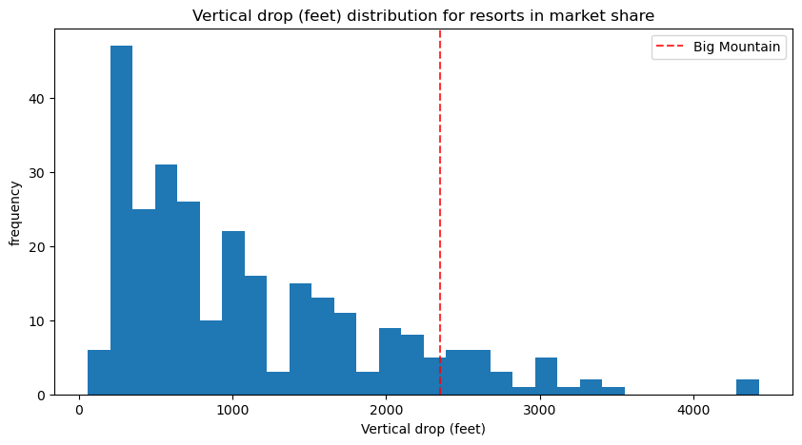
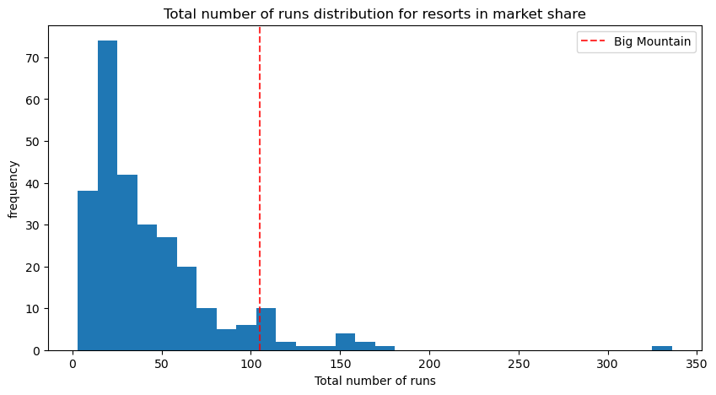
Big Mountain Current Standings

Slide 4
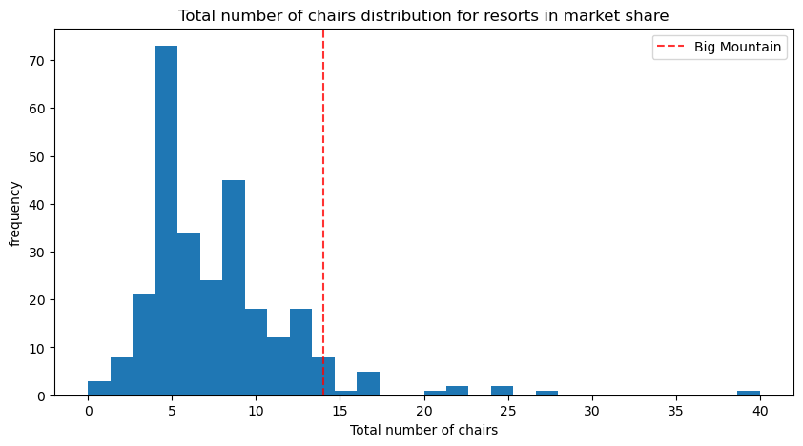
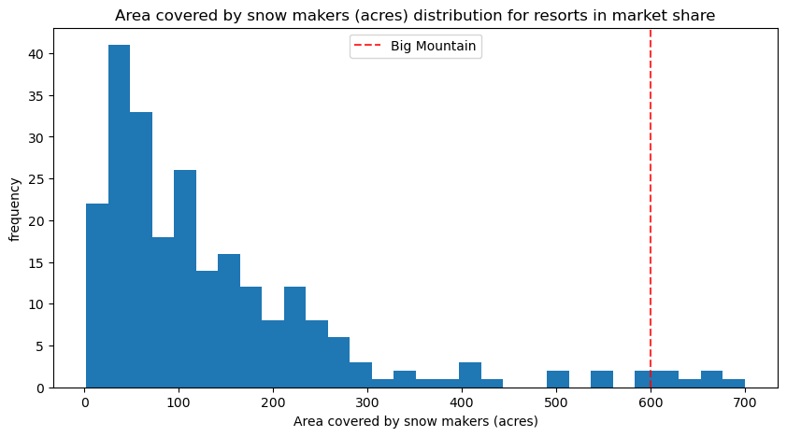
Big Mountain Current Standings

Slide 5
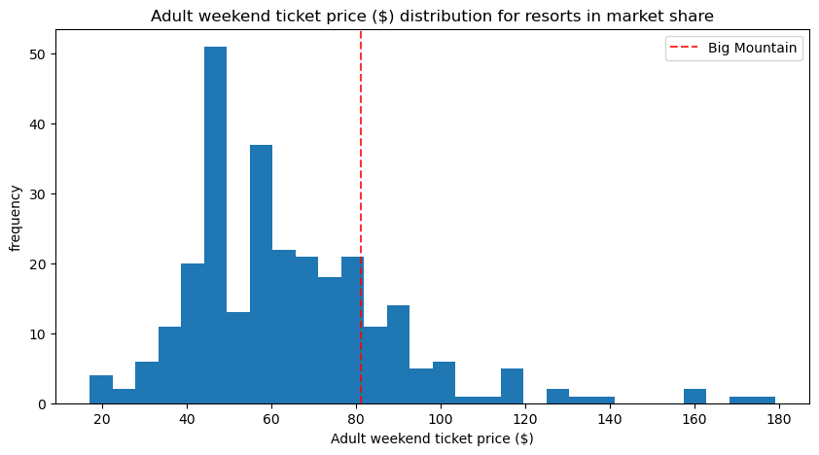
New Scenario: No Action Price Increase
12% + AdultWeekend
At a 12% increase to the AdultWeekend ticket this would put Big Mountains AdultWeekend price at $91 still keeping us in the 15% of current market share.
The model's effectiveness was measured using metrics such as R-squared, Mean Absolute Error (MAE), and Mean Squared Error (MSE). These metrics confirm the model's strong fit and its ability to predict ticket prices accurately, reinforcing confidence in the recommendations provided.

Slide 6
Summary
Pricing Adjustment
Big Mountain Resort should consider revising its ticket prices to better align with the value provided by its key features. The current pricing structure may not fully capture the potential revenue the resort could generate.
Strategic Planning
Ongoing monitoring of market trends and customer preferences is recommended to ensure that the pricing strategy remains competitive. Future analyses could incorporate more detailed scenario modeling or integrate customer feedback data to refine pricing further.

Slide 7
Big Mountain Resort

